Slide 1
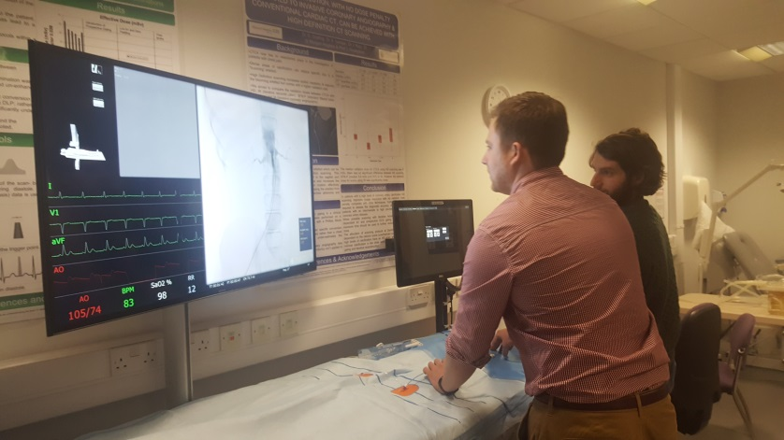
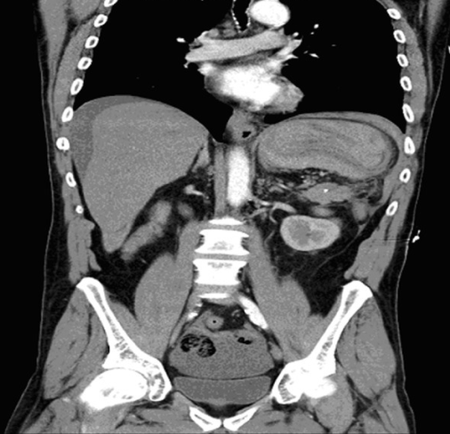
Virtual Open Day 2021 Monday 15th November
Considering a career in Radiology?
Find out about radiology training in the South West.
Informative seminars from leading local clinicians .
Learn about the unique academy learning environment.
Tips for applications/interviews
Certificates for all attendees!
Enter the poster competition!
Prepare an A1 poster on “A radiological case which inspired me to consider Radiology.”
Prize available for the best poster.
Deadline for applications 08/11/21.
(Posters will be displayed and accessible to those viewing the website for the day. Patient identifiable information must be anonymised.)
Register now for only £5
For full details, please visit penra.org.uk/open-day

